Slide 1
First Steps towards a Frequent Pattern Mining with Nephrology Data in the Medical Domain CS&P 2012: 261-268 Matthias Niemann¹ , Danilo Schmidt², von Trzebiatowski³ 1Department of Transfusion Medicine ^{2Department of Nephrology} ^{Humboldt University of Berlin} 3Department of Computer Science
Presenter: Chang, Hsin-Hsiung

Slide 2
Introduction
Statistic analysis
Regular way
an intuition of interesting parameters
Data mining
Avoid intuition, because an artificial system has no intuitive preconditions
processing of a huge amount of data with the possibility of getting details of potential interests in short time
Big Data?

Slide 3
Introduction
One of the main challenges is the handling of this huge amount of data
Uses data mining in the medical domain
Kidney transplantation
Less donor organ
identify important factors retrospectively which affect organ survival rate

Slide 4
Data source
3 Berlin’s nephrological departments
12000 cases
Use web-based Electronic Patient Record database Tbase to storage data

Slide 5
Web-based Electronic Patient Record TBase
Cooperation between the Nephrology of Charite Campus Mitte and Campus Virchow and the AI Lab of the Institute of Computer Sciences of Humboldt University of Berlin
TBase automatically integrates essential data from the laboratory, clinical pharmacology, nuclear medicine

Slide 6
Web-based Electronic Patient Record TBase
Different standardization organizations (HL7, OpenEHR, IEEE, ISO, CEN, …), no common accepted integrative standard exist.
To fill in this gap the German Research Foundation (DFG) established a new priority program

Slide 7
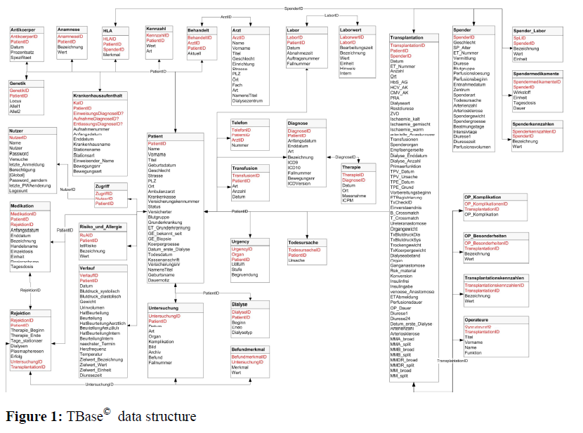

Slide 8
Pre-processing of the medical data

Slide 9
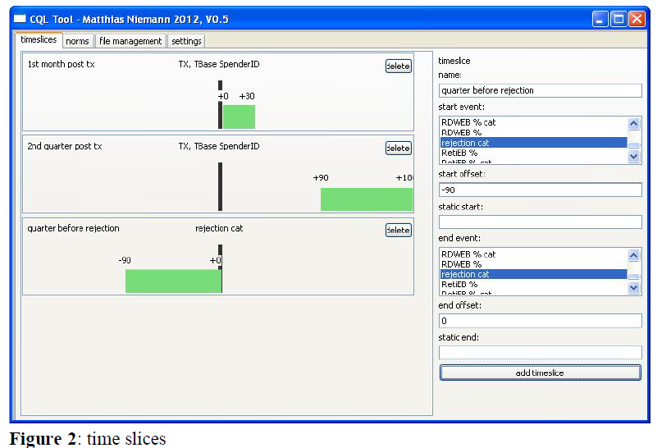

Slide 10
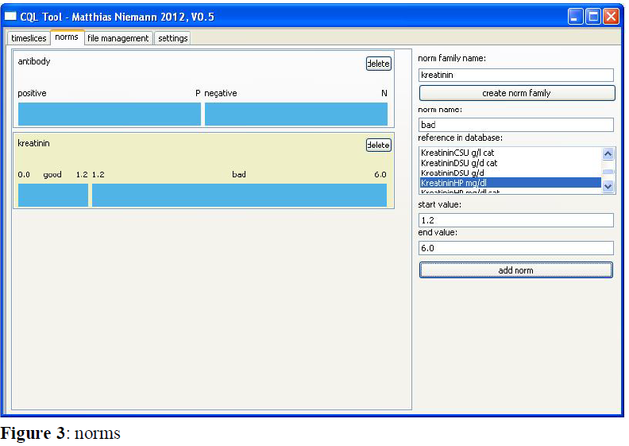

Slide 11
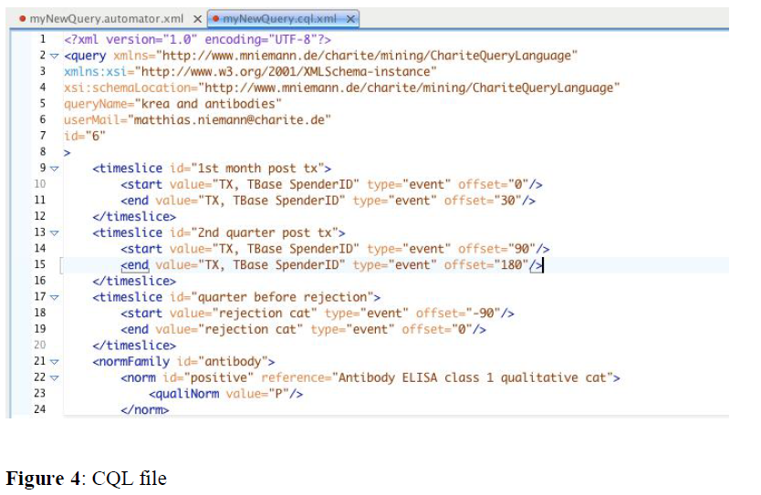
CQL (Charité Query Language)

Slide 12
Frequent Pattern Mining
Apriori
Uses breadth-first search and a Hash tree structure to count candidate item sets efficiently
Find the frequent itemsets: the sets of items that have minimum support
A subset of a frequent itemset must also be a frequent itemset

Slide 13


Support threshold
Confidence threshold
Possibility of (RHB|LHB)

Slide 14
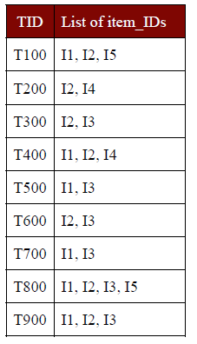

Slide 15
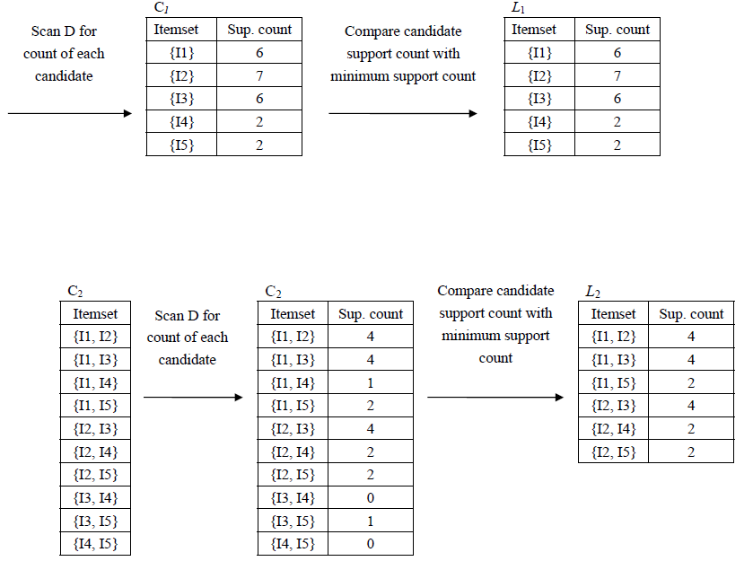

Slide 16
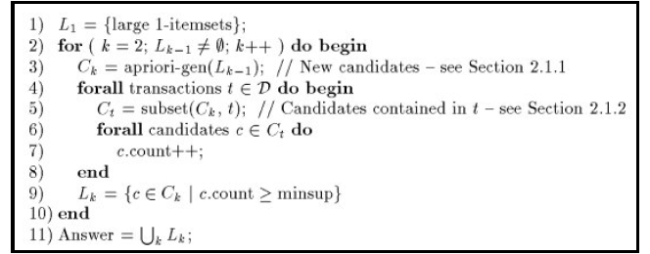

Slide 17
Conclusion
Data integration
Built a tool
The plan is to use a FP-Growth Algorithm
No Final report

